Slide 1


Digital Control in Power Electronics
杭丽君
ljhang@hdu.edu.cn
可再生能源及微型电力网技术实验室
Regeneration energy and microgrid Technology Lab(REMT)

Slide 2
课 程 内 容
Introduction: Digital Control Application to Power Electronic Circuits
The Test Case: a Single-Phase Voltage Source Inverter
Digital Current Mode Control
Extension to Three-Phase Inverters
External Control Loops

Slide 3
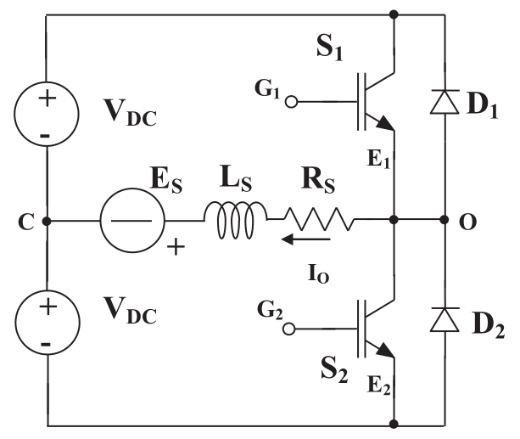
2.1 THE VOLTAGE SOURCE INVERTER
a single-phase half-bridge voltage source inverter (VSI)

Slide 4
2.1.1 Fundamental Components
The ideal voltage sources, the input
power switches (the conventional IGBT symbol, but can be replaced by power MOSFETs or thyristors)
the load, the series connection of a resistor R_{s} an inductor L_{s} and a voltage source E_{s} ,which can be either dc or ac.
a free-wheeling diode
a four-quadrant converter, with the capability of both delivering and absorbing power.

Slide 5
2.1.1 Fundamental Components
In order to simplify the treatment of our control problems and without any loss of generality, we will assume that the switch plus diode couple behaves like an ideal switch, i.e., one whose voltage is zero in the “on” state and whose current is zero in the “off” state. Moreover, we will assume that the change from the “on” state to the “off” state and vice versa takes place in a null amount of time.

Slide 6
2.1.2 Required Additional Electronics: Driving and Sensing
Several components are needed to allow the proper operation of the VSI:
the power switches need to be driven by a suitable control circuit, allowing the controlled commutation of the device from the “on” to the “off” state and vice versa. Depending on different switch technologies, suitable drivers must be adopted accordingly.
The acquisition of voltage and other signals requires suitable signal conditioning circuits, analog in nature, for example those employing operational amplifiers, to implement active filters and signal scaling, or Hall sensors, to measure currents without interfering with the power circuit.

Slide 7
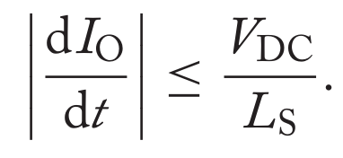
2.1.3 Principle of Operation
The principle of operation of the half-bridge inverter:
Considering, as an example, the particular case where E_{s} and R_{s} are
both equal to zero, the current I_{o} will be limited in its variations：
Any controller trying to impose voltages, currents, or current rates of change beyond the above-described limits will not be successful: the limit violation will simply result in what is called inverter saturation.

Slide 8
2.1.3 Principle of Operation
modulator and current control levels:
In the lowest level a controller determines the state of each of the two switches, and in doing so, the average load voltage. This level is called the modulator level. The strategy according to which the state of the
switches is changed along time is called the modulation law.
the current controller set-point can be provided by a further external control loop or directly by the user. In the latter case, the VSI is said to operate in current mode, meaning that the control circuit has turned a voltage source topology into a controlled current source.

Slide 9
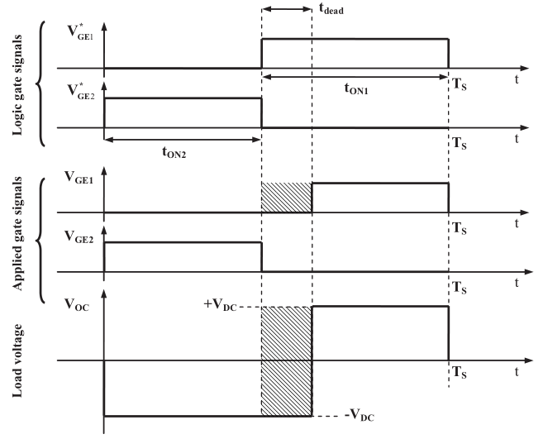
2.1.4 Dead-Times
Switching dead-time:
would indeed result into a short circuit across the input voltage sources, leading to an uncontrolled current circulation through the switches and, very likely, to inverter fatal damage.

Slide 10
2.1.4 Dead-Times
Dead-times effect: when a positive current I_{o} flows through the load, the actual on time for switch S₁ is shorter than the desired one. Consequently,the average voltage across the load is different from the desired one.

Slide 11
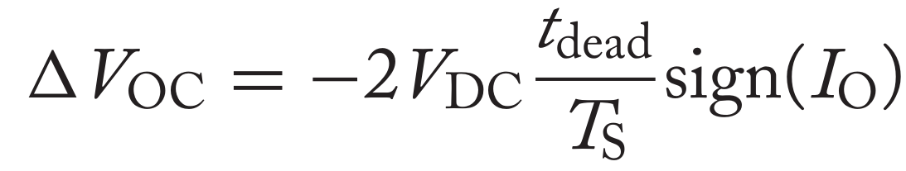
2.1.4 Dead-Times
Because of dead-times, no matter what the modulator implementation is, an error on the load voltage will always be generated, whose entity is a direct function of the dead-time duration and whose polarity depends on the load current sign according to the relation above, which will have to be compensated by the current controller.

Slide 12
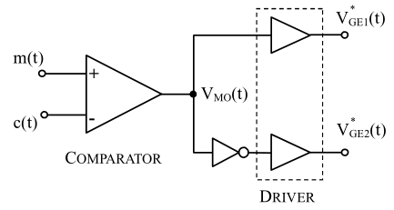
2.2 LOW-LEVEL CONTROL OF THE VOLTAGE SOURCE INVERTER: PWM MODULATION
Pulse density modulation
pulse frequency modulation
PWM
Advantages：
ease of implementation
Constant frequency inverter operation
immediatede modulation by means of simple low-pass filters…
A simple PWM circuit

Slide 13
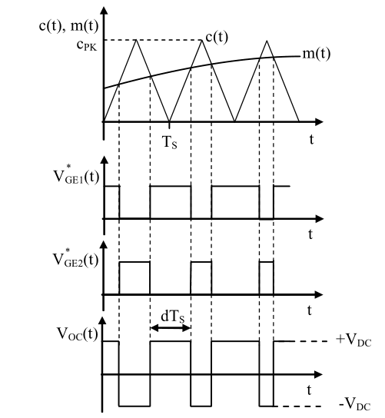
2.2.1 Analog PWM: the Naturally Sampled Implementation
Analog implementation of a PWM modulator. The analog comparator determines the state of the switches by comparing the carrier signal c(t) and the modulating signal m(t). The figure shows the logic state of each switch and the resulting inverter voltage. No dead-time is considered.

Slide 14
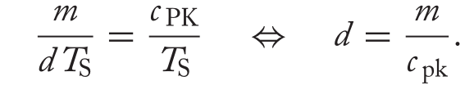
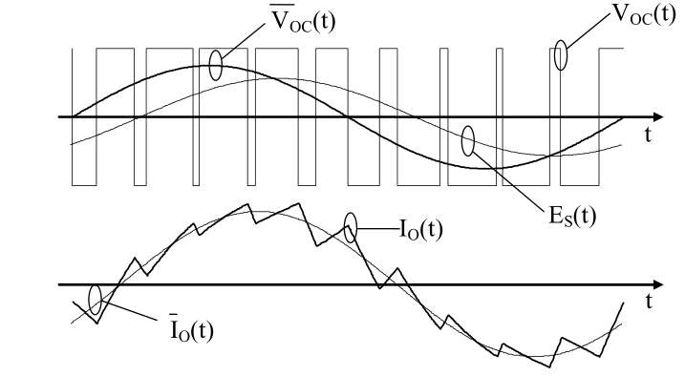
2.2.1 Analog PWM: the Naturally Sampled Implementation
In each modulation period, where a constant m is assumed, the equation holds:
Example of PWM application to the VSI. The instantaneous load voltage V _{OC} (t) is demodulated by the low-pass filter action of the inverter load. The resulting load current
I _{O} (t) has an average value, whose waveform is determined by the instantaneous voltage average value V _{OC} (t) (and by the load voltage E _{S} , here assumed to be sinusoidal).

Slide 15
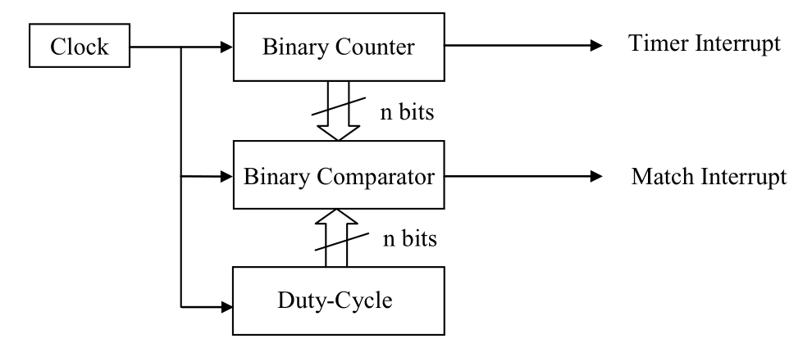
2.2.2 Digital PWM: the Uniformly Sampled Implementation

Slide 16
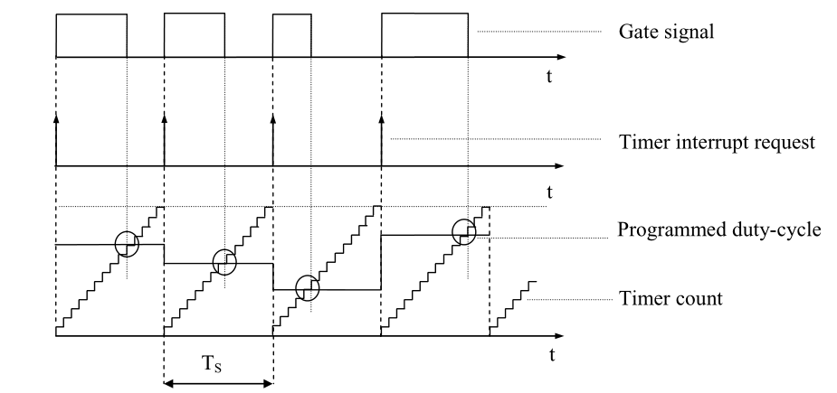
2.2.2 Digital PWM: the Uniformly Sampled Implementation
Simplified organization of a digital pulse width modulator. The binary comparator triggers an interrupt request for the microprocessor any time the binary counter value is equal to the programmed duty-cycle (match condition). At the beginning of the counting period, the gate signal is set to high and goes low at the match condition occurrence.

Slide 17
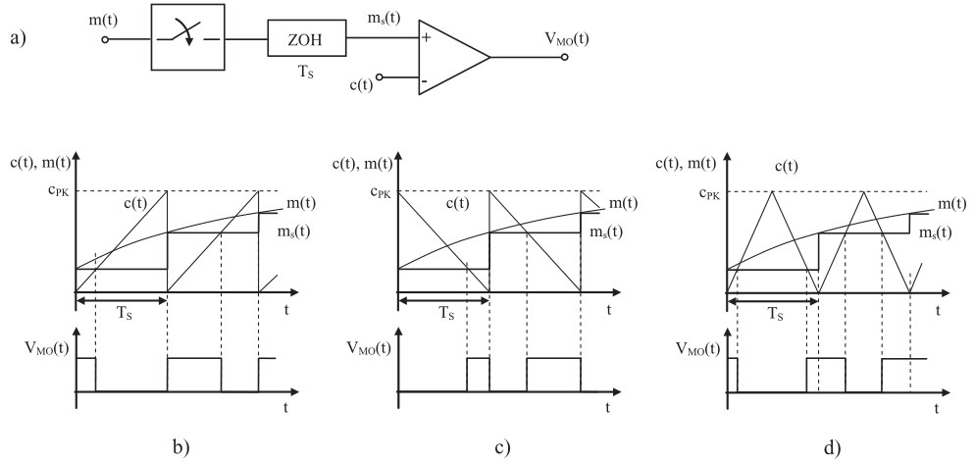
2.2.2 Digital PWM: the Uniformly Sampled Implementation
Uniformly sampled PWM with single update mode: (a) general block diagram,
(b) trailing-edge modulation, (c) leading-edge modulation, (d) triangular carrier modulation

Slide 18

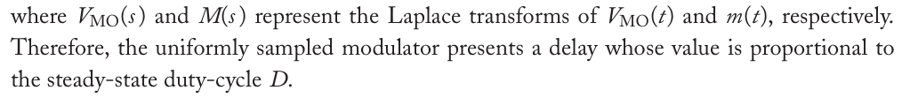


2.2.2 Digital PWM: the Uniformly Sampled Implementation
the leading-edge modulation(c):
the triangular carrier modulation(d):

Slide 19
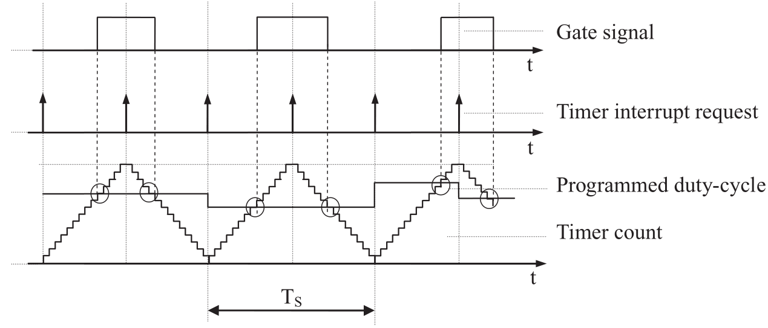
2.2.3 Single Update and Double Update PWM Mode
Double update mode of operation for a digital pulse width modulator. Duty-cycle update is allowed at the beginning and at a half of the modulation period. Note that the gate pulses are now symmetrically allocated within the modulation period (in steady state).

Slide 20
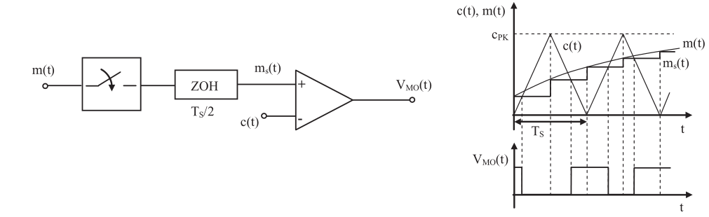
2.2.3 Single Update and Double Update PWM Mode
Model of the uniformly sampled PWM with double update.

Slide 21

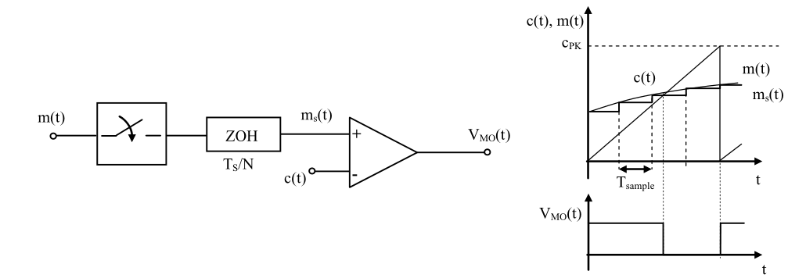
2.2.3 Single Update and Double Update PWM Mode
Multi-sampled PWM

Slide 22


2.2.4 Minimization of Modulator Delay: a Motivation for Multisampling
the low-frequency, small-signal behavior of the multisampled digital PWM is again that of a pure delay,
but the equivalent delay time is now given by

Slide 23
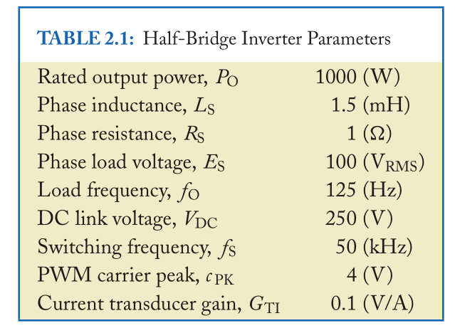
2.3 ANALOG CONTROL APPROACHES
Two possible analog implementations of a current control loop: the PI linear controller and the nonlinear hysteresis controller.

Slide 24
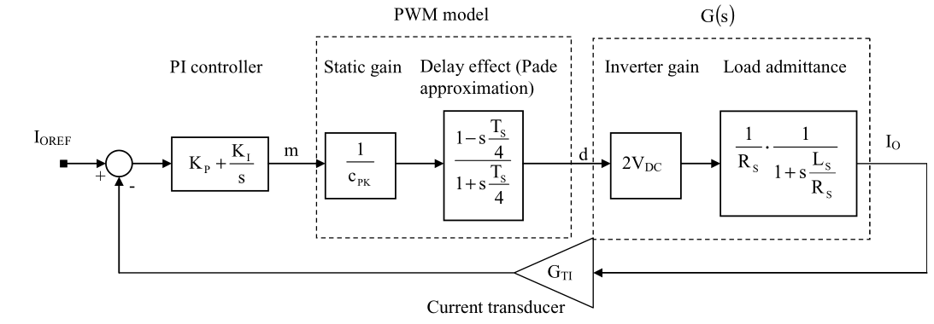
2.3.1 Linear Current Control: PI Solution
the control loop block diagram, where all the components are represented by their respective transfer functions or gains

Slide 25
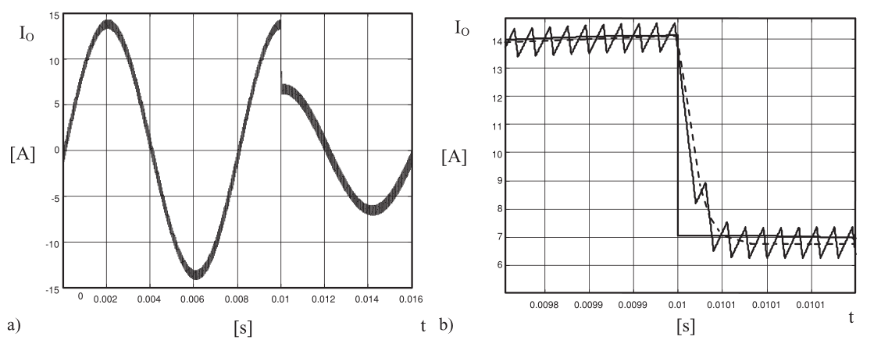
2.3.1 Linear Current Control: PI Solution
(a) Controller response to a step reference amplitude change. (b) Details of the previous figure.
Simulation of VSI

Slide 26
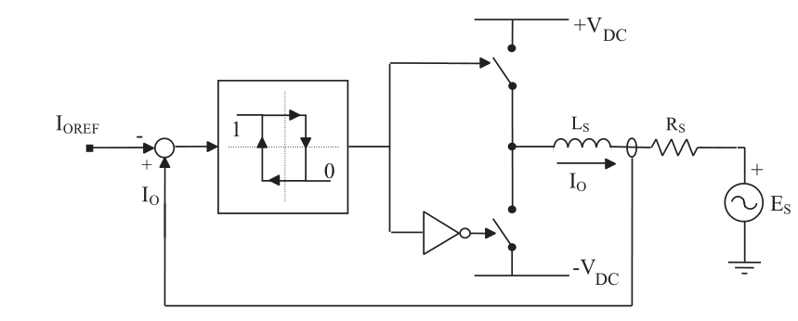
2.3.2 Nonlinear Current Control: Hysteresis Control
Hysteresis current control hardware organization.

Slide 27
2.3.2 Nonlinear Current Control: Hysteresis Control
1) an analog comparator is fed by the instantaneous current error, and
its output directly drives the converter switches.
2)Thanks to the VSI topology and to the fact that the dc link VDC voltage will always be higher than the output voltage E_{S} peak value, the current derivative sign will be positive any time the high-side switch is closed and negative any time the low-side switch is closed. This guarantees that the controller organization in the figure will maintain the converter output current always close to its reference.
3)Under the limit condition of zero hysteresis bandwidth, the current error can be forced to zero as well: unfortunately this condition implies an infinite frequency for the switch commutations, which is,
of course, not practical. In real-life implementations, the hysteresis bandwidth is kept sufficiently
small to minimize the tracking error without implying too high switching frequencies. As
a consequence, also the compensation of dead-time induced current distortion will be very
good.

